Slide 1

Presentation
On
6 Months Internship at “Hitachi Solutions India Pvt. Ltd.”
Presented by:
Name: Aniket Khadgi
Role: Intern
Internship Duration: 8th Jan- 4th July 2025
Project Title: “VibeCart” - An Ecommerce
Platform for Online Shopping
Technologies: .NET 8, Angular , SQL Server, AI Service using Botpress
Company Mentors:
Mr. Sandesh Rahate
Mr. Hiten Bhatt
Mr. Dinesh Mudaliyar
Company : Hitachi Solutions India Pvt. Ltd.

Slide 2
Contents
Introduction
Project Statement
Design and Methodology
Work done
Photos while Working
Conclusion
References

Slide 3

Introduction
VibeCart- An Ecommerce Platform
Platform Purpose: A seamless online shopping experience, 24/7 AI chatbot assistance
Features:
Product Catalogue
User Authentication and Authorization
Shopping Cart
Order Management
Admin Dashboard
Stock Management

Slide 4

Project Statement
Need for a scalable and efficient ecommerce platform
Issues with existing platforms (complexity, security concerns, high costs for small businesses)
Importance of integrating frontend, backend, and database effectively.
Addressing security and performance challenges

Slide 5
Design and Methodology
Architecture:
Three-tier structure: Frontend (Angular), Backend (.NET 8), Database (SQL Server)
Core Features:
User Authentication and Authorization using .NET 8
Product listing and search functionality
Shopping cart and checkout process
Order management system
Admin Dashboard
Security Measures:
JWT Authentication
Role-based access control
Payment Integration
Payment Gateway Integration facilitates secure online transactions through Stripe, streamlining the payment process for customers.

Slide 6
Work Done
Project Setup:
Created an ASP.NET Core Web API project in Visual Studio.
Configured Angular for frontend development in VS Code.
Set up SQL Server database.
Frontend Development (Angular):
Designed an attractive and user-friendly UI structure for the platform.
Developed user authentication pages .
Implemented product listing with clickable cards that redirect to detailed product pages.
Developed user profile section with editable account details.
Added “Your Orders” and “Track Order” .
Added Admin Dashboard ,Stock Management, Product Management.
Backend Development (.NET 8):
Created API endpoints for user authentication (Signup, Login)
Developed secure APIs for product listing, product details, cart operations, and order management ,Admin Dashboard.
Integrated payment gateway and order placement logic.
Set up user-specific cart and order tracking using user ID.

Slide 7
Work Done
Testing & Integration:
Connected frontend with backend using RESTful API endpoints.
Using Swagger for testing APIs.
Debugged and optimized performance issues.
Ensured smooth integration of frontend-backend and proper flow of user actions.

Slide 8
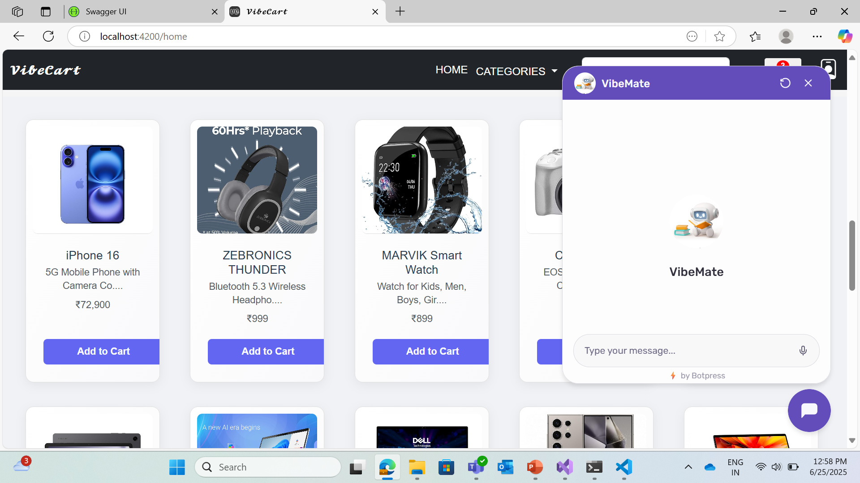
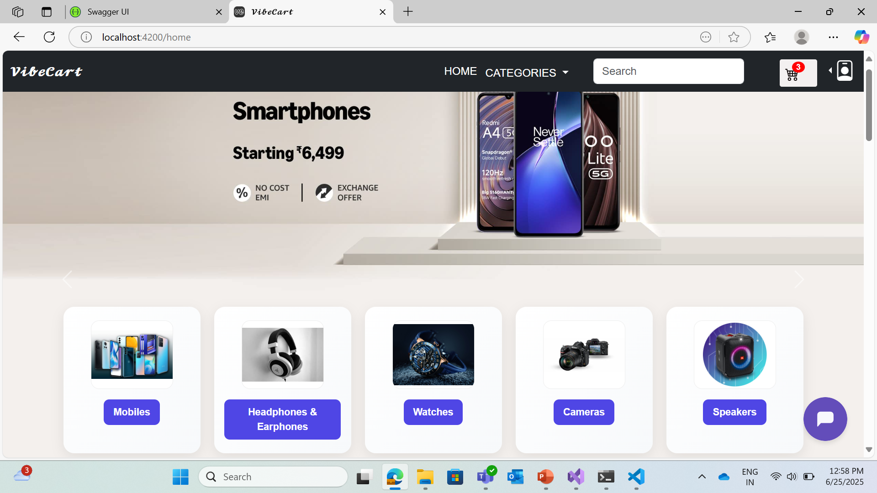
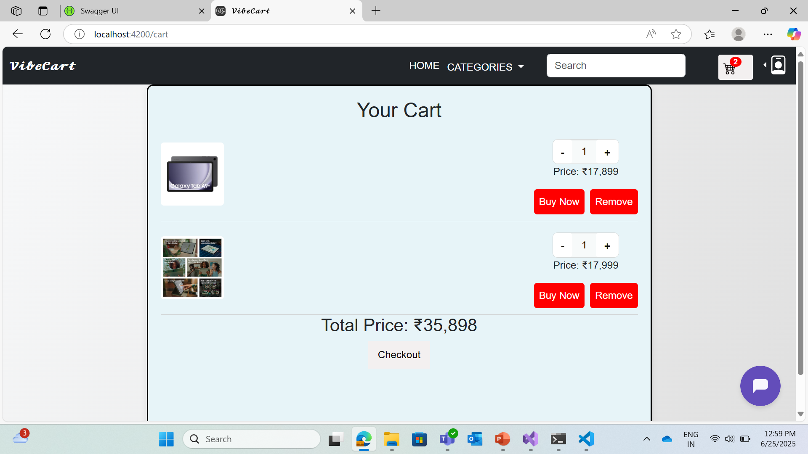
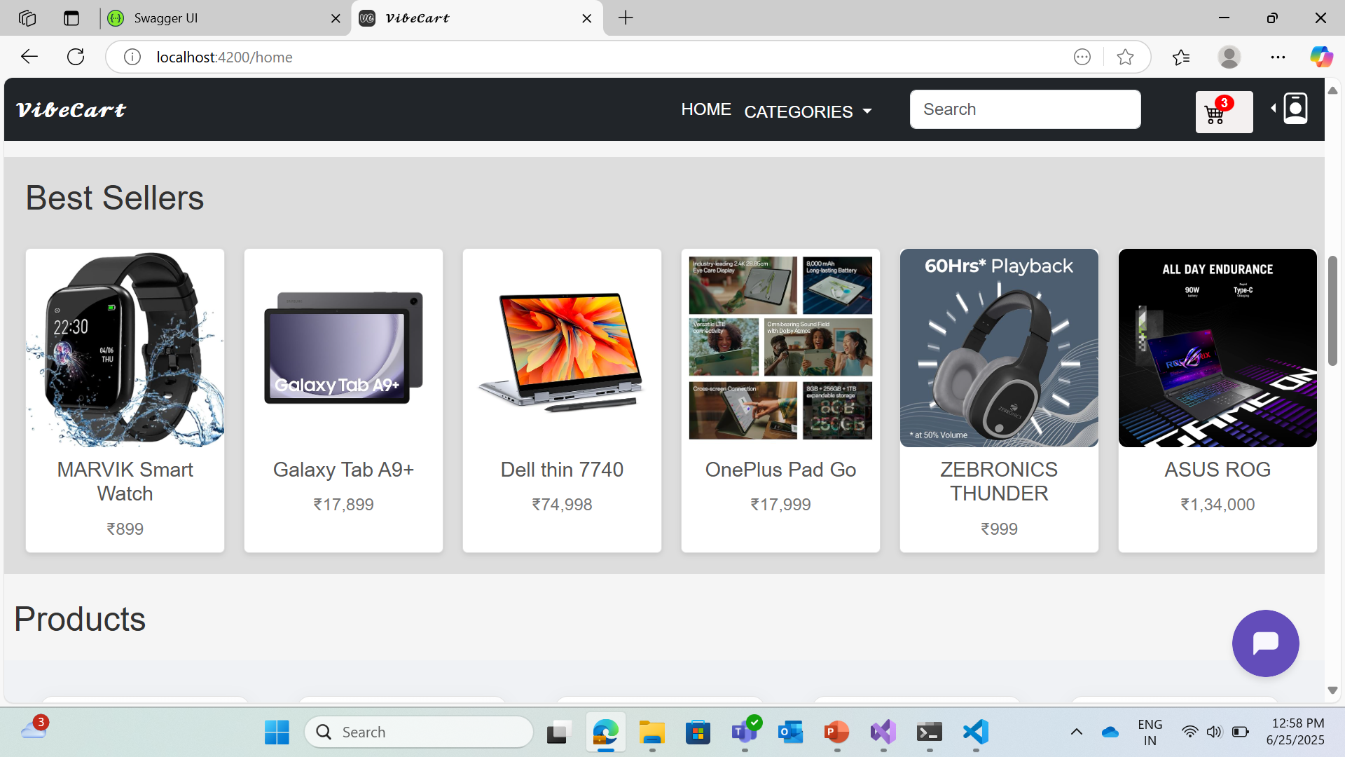
Work Done

Slide 9
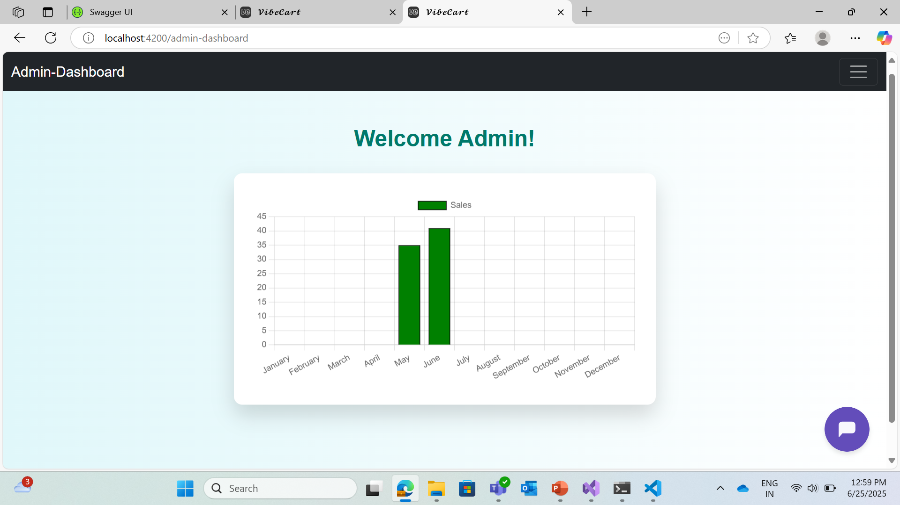
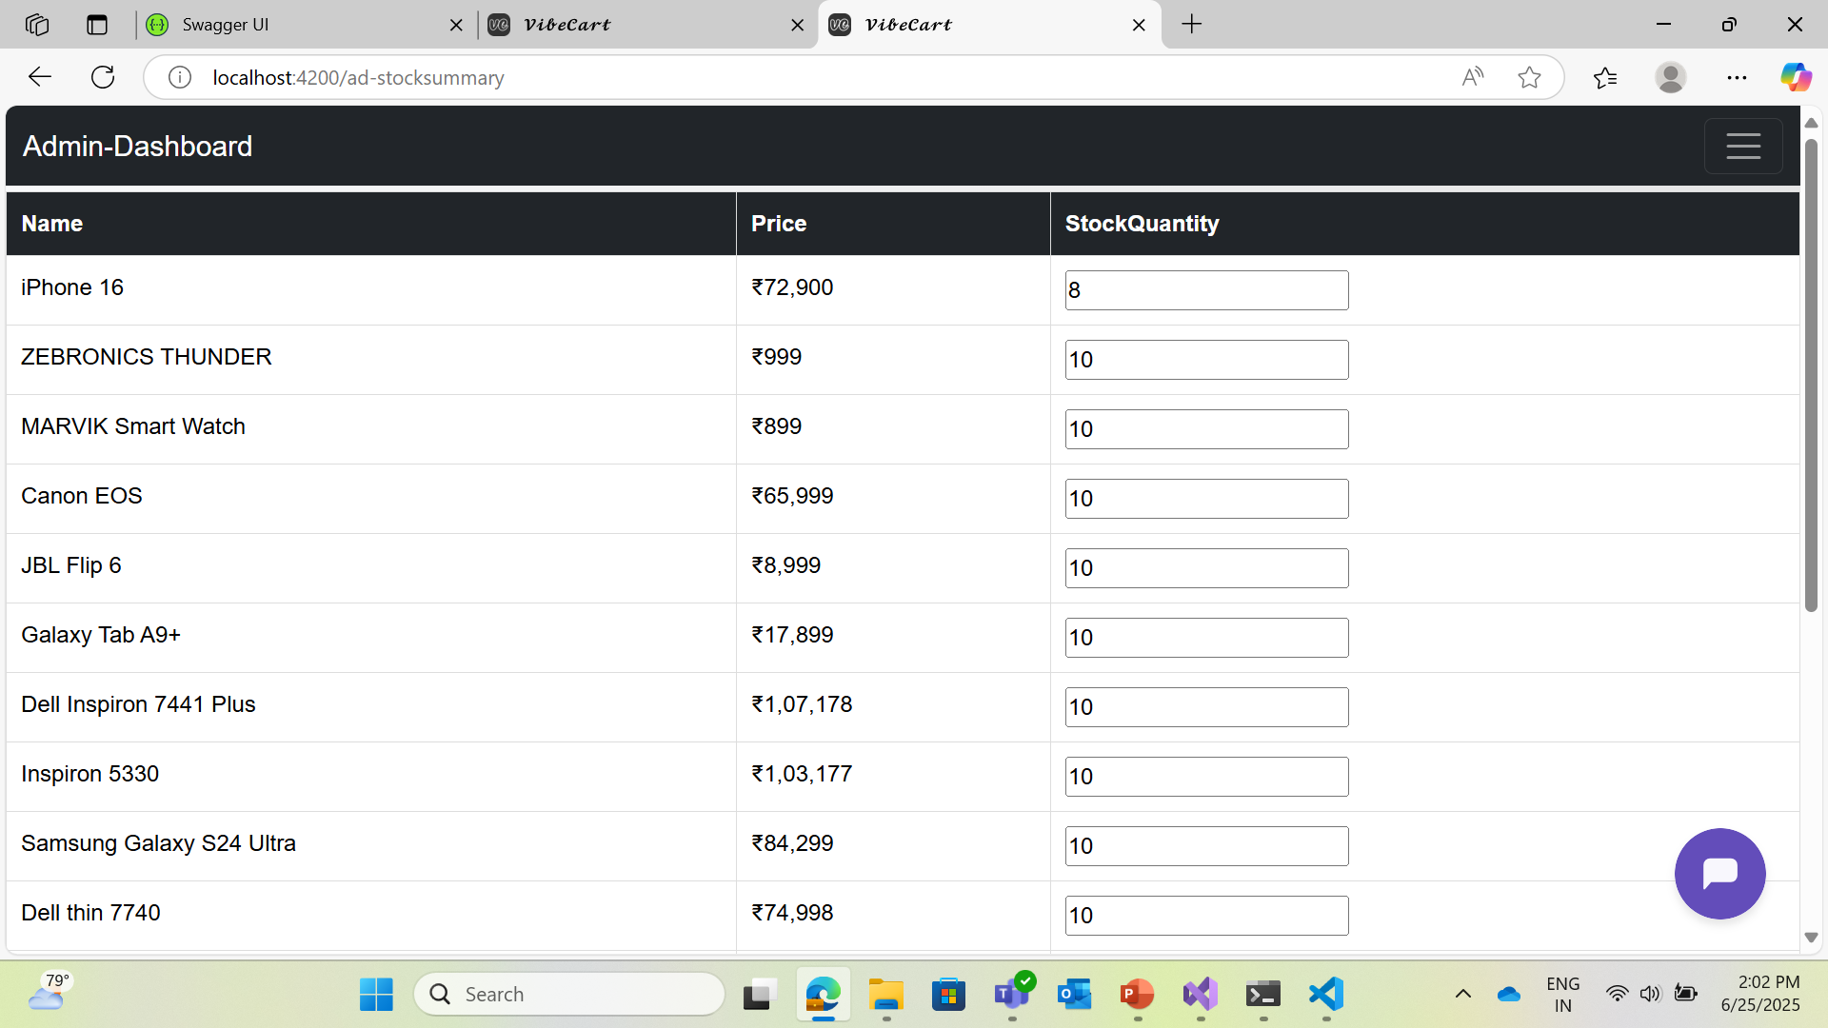
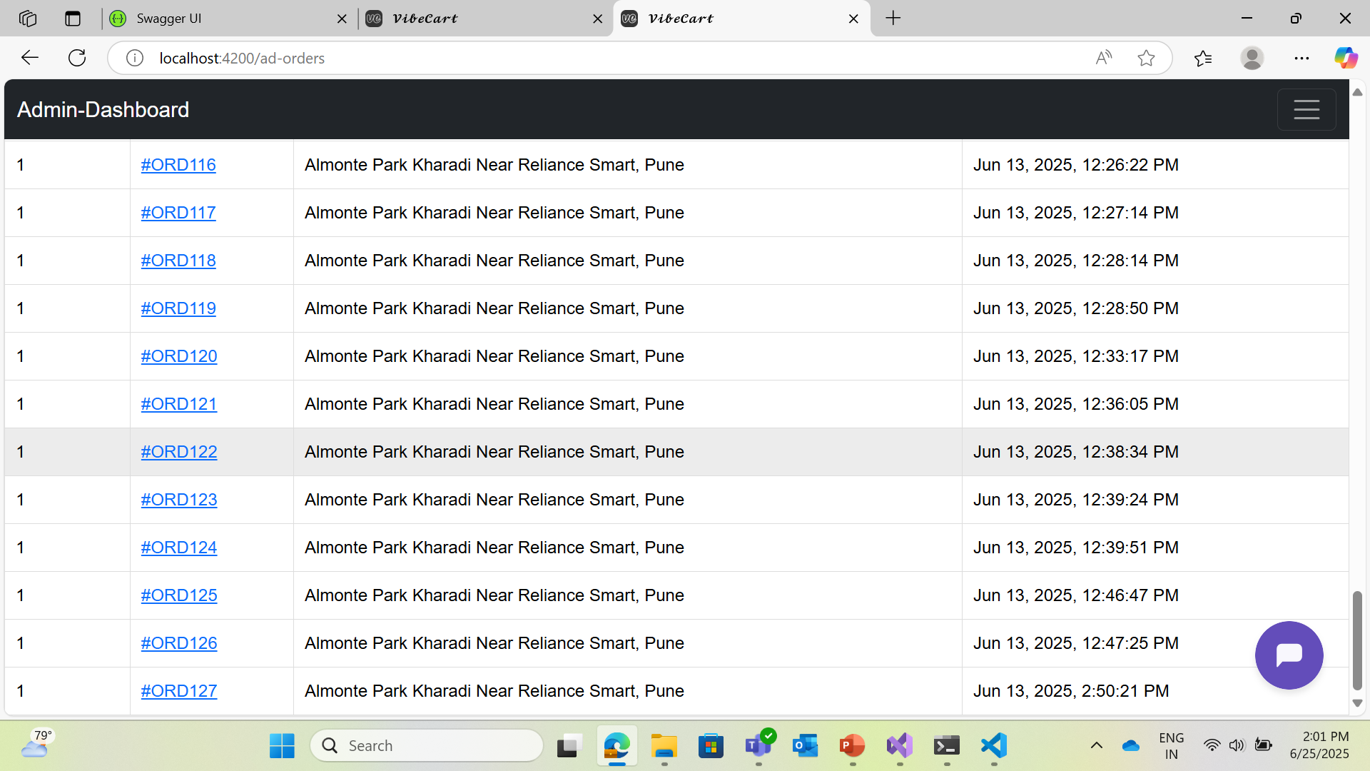
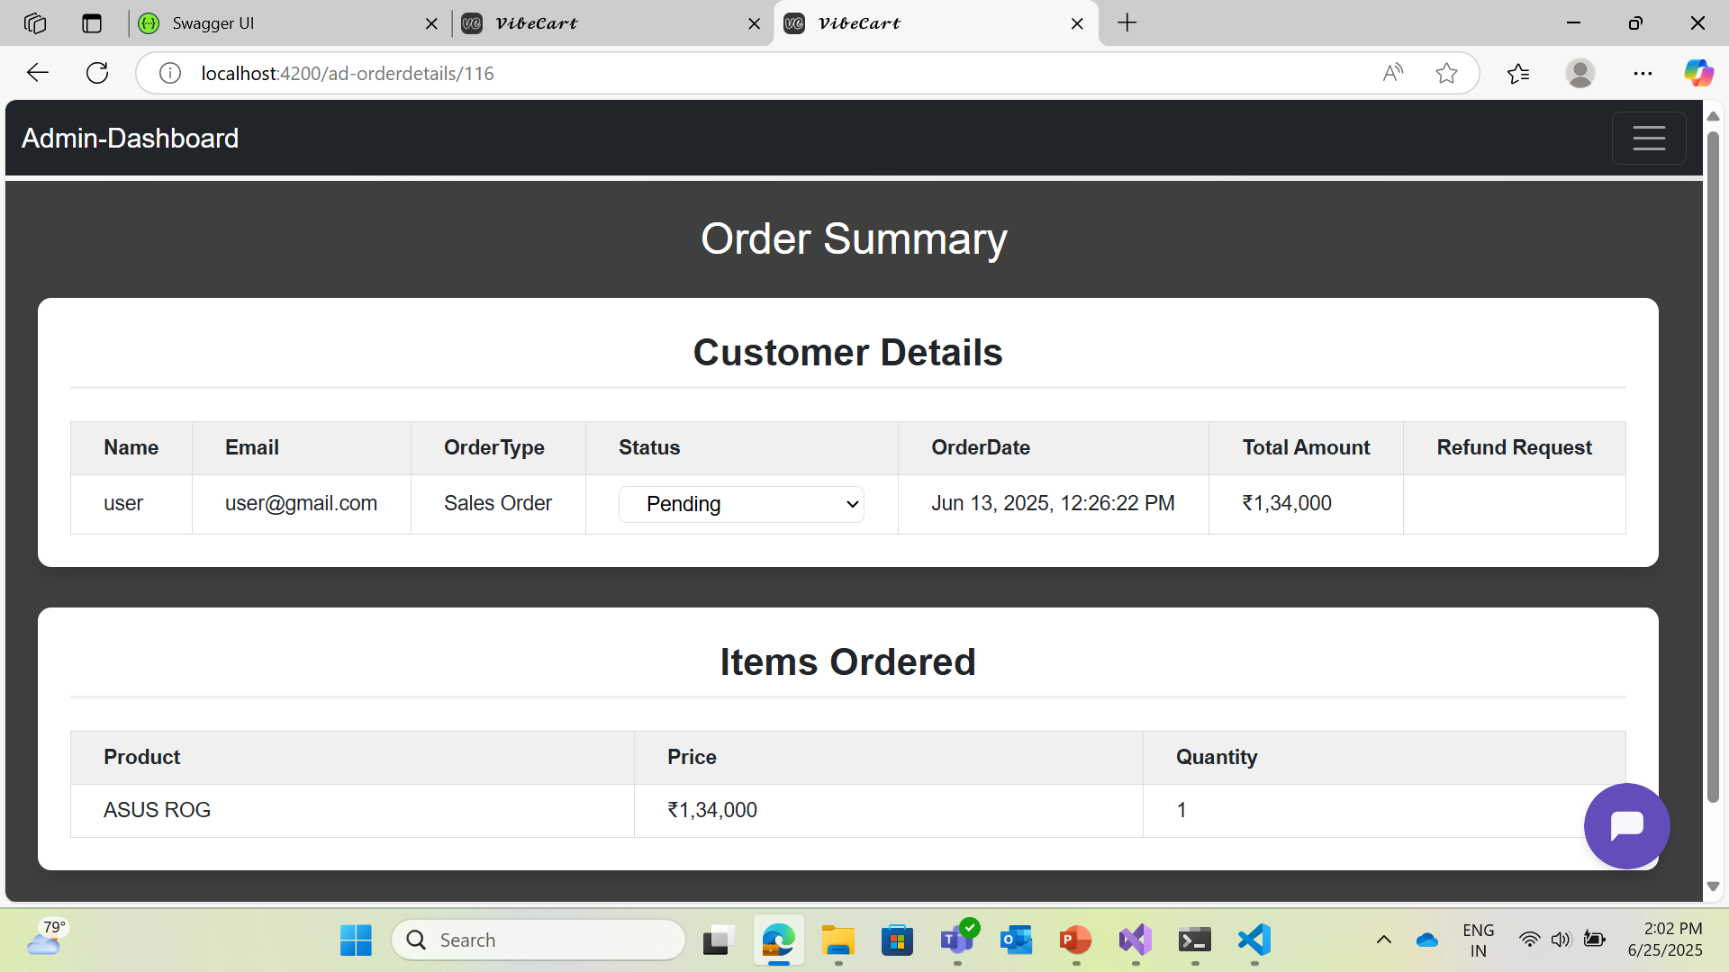

Slide 10
Conclusion
Building a functional Ecommerce Website
Developed a complete functional Ecommerce platform
Integrated key features: User Authentication, Payment, Cart, Orders, Chatbot
Applied .NET 8, Angular, SQL Server, JWT, Botpress
Gained end-to-end full stack development experience
Ready to contribute as a Full Stack Developer
AI Chatbot Assistance
Using 24/7 chatbot assistance to the customers for the queries using Botpress.

Slide 11
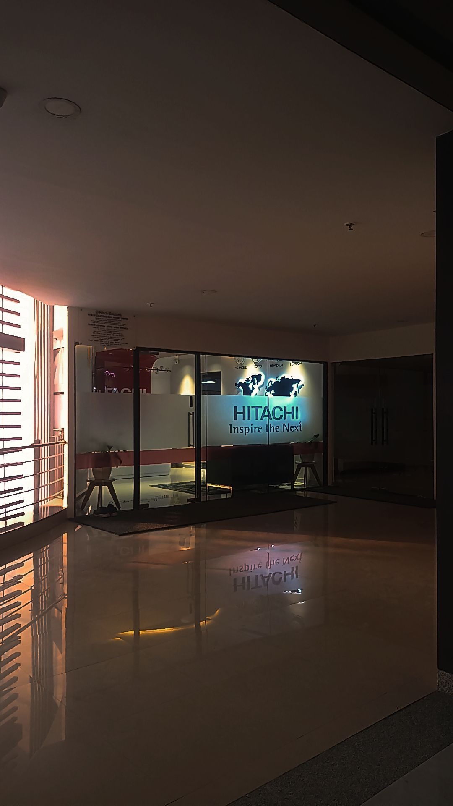
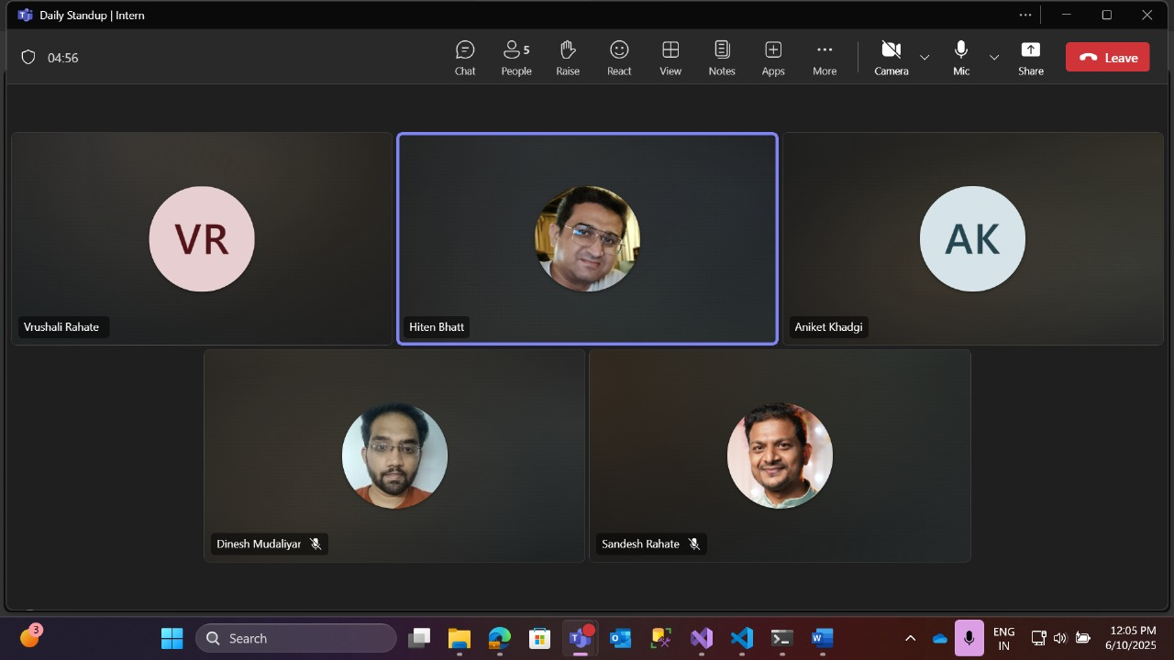
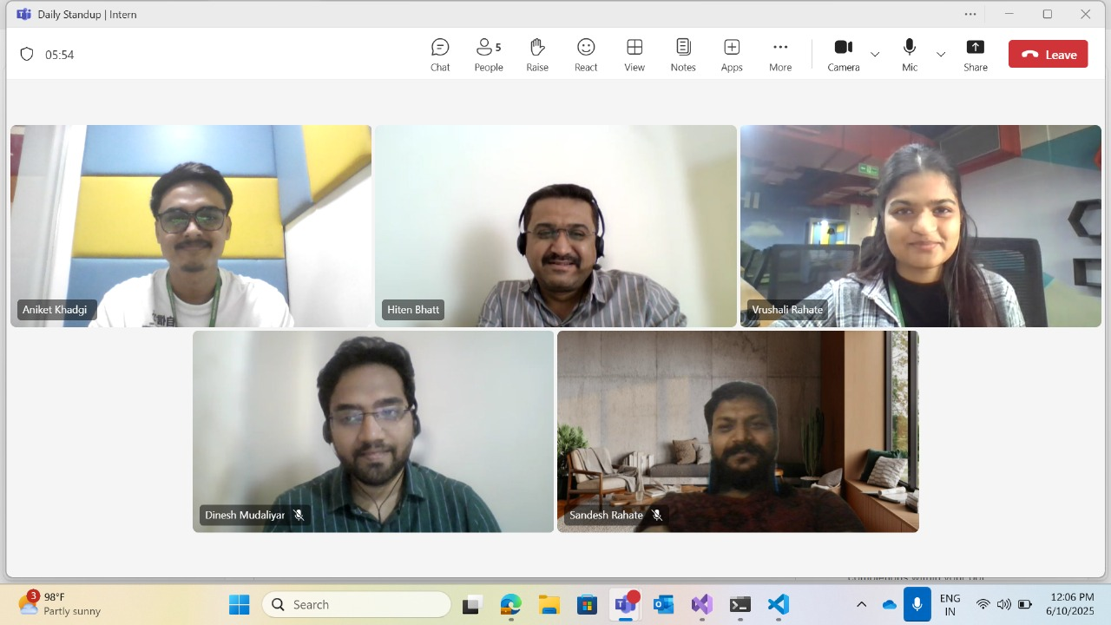
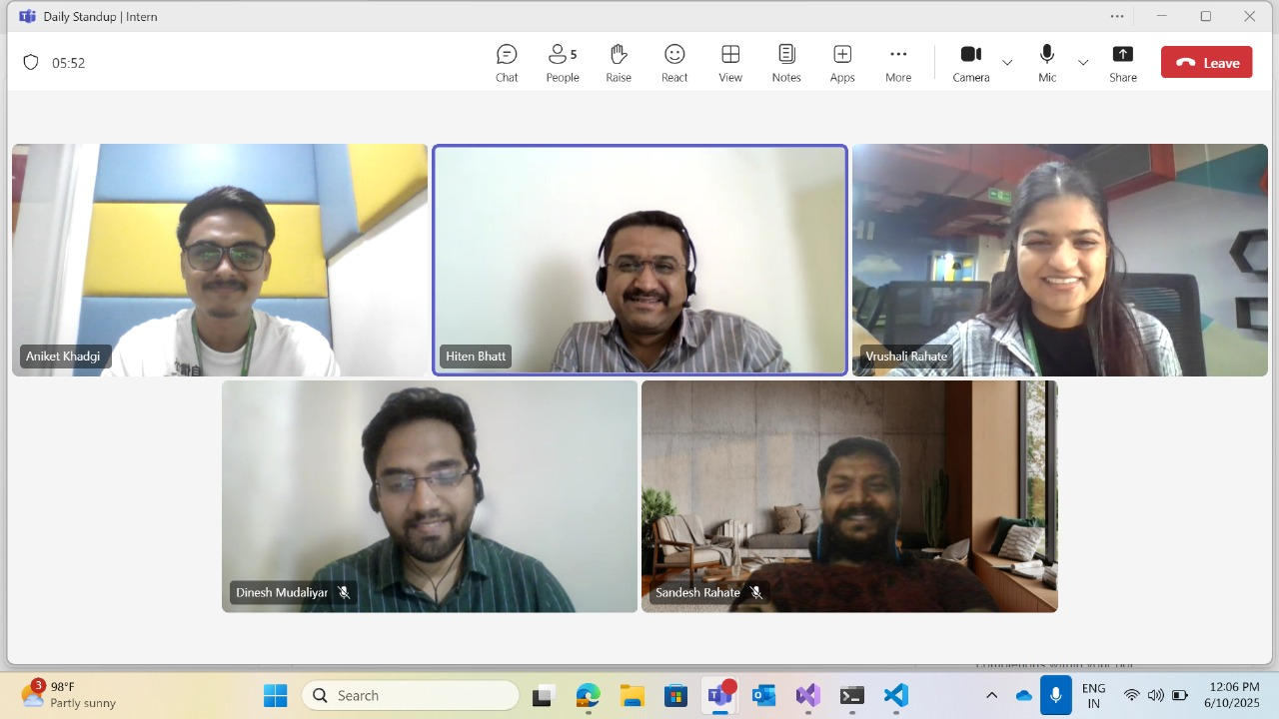
Photos While Working

Slide 12
1. Microsoft Docs – ASP.NET Core Web API https://learn.microsoft.com/en-us/aspnet/core/web-api
2. Angular Official Documentation https://angular.io/docs
3. Stripe API Documentation – Refunds https://stripe.com/docs/api/refunds
4. Entity Framework Core – Microsoft Docs https://learn.microsoft.com/en-us/ef/core/
5. W3Schools – Web Development Tutorials https://www.w3schools.com
6. GeeksforGeeks – Full Stack Project Resources https://www.geeksforgeeks.org
7. Hitachi Enterprise Chat
References

Slide 13

Thank You

